Slide 1
B-STAT-303 Hypothesis Testing
FARHANA HASAN
Assistant Professor
Department of Statistics
University of Rajshahi
Email: fswatee07@yahoo.com

Slide 2
Some definitions and terms
Population
The complete set of people or things being studied
All possible values
Sample
A subset or portion of the population that is actually studied (and from which the raw data are actually obtained)
A group of units selected from a larger group(the population). By studying the sample it is hoped to draw valid conclusions about the population.

Slide 3
Statistical inference
generalizing from a sample to a population with calculated degree of certainty
To estimate the unknown population characteristic (parameter) and to infer about that parameter
Two forms of statistical inference :
Estimation
Hypothesis testing

Slide 4
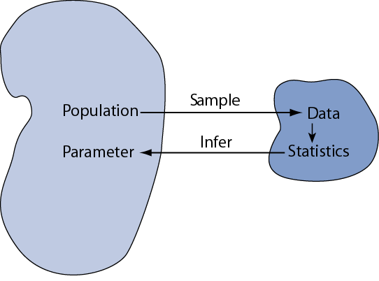

Slide 5
Test of hypothesis
In statistics, a hypothesis is a claim or statement about a property of a population
The inference is drawn on the basis of probability distribution of the sample statistic (calculated from data in the sample) or estimator.
The process of making inference about parameter using sample statistic is known as test of hypothesis or test of statistical hypothesis
Types of statistical hypothesis
Parametric hypothesis
Non-parametric hypothesis

Slide 6
Parametric hypothesis
The unknown population characteristic is called parameter and any specification about one or more parameters is termed as parametric hypothesis.
This is done when the distribution of population observations is specified or known.
For example the distribution of measurement errors in measuring the ages of a randomly selected group of people can be assumed normally distributed with population mean μ and population variance σ² . Here μ and σ² termed as parameters. Any specification which about μ and σ² which is under verification is known as parametric hypothesis.

Slide 7
Nonparametric hypothesis
The hypothesis which does not specify anything about the parameters of a distribution is called nonparametric hypothesis.
For example a group of students are selected for some social activities. One may be interested to verify the hypothesis that the selection is random. Here nothing is mentioned about the parameter. So the hypothesis is nonparametric hypothesis

Slide 8
Statistical hypothesis
A statistical hypothesis is an assertion about the distribution of one or more random variables.
If the statistical hypothesis completely specifies all the parameters of a distribution or a distribution itself it is called a simple statistical hypothesis, if it does not it is called a composite hypothesis.
If in investigating the significance of a hypothesis all parameters of the distribution or the distribution itself are specified, then the hypothesis is known as simple hypothesis

Slide 9
If by a hypothesis all the parameters of a distribution or distribution itself are not specified, the hypothesis is called composite hypothesis.
For example, let X~ N(μ, σ² ). The object is to test the significance of H₀: μ = μ₀ against H₁: μ ≠ μ_{0.} Here one can assume that σ² is known. In such a case the hypothesis is called simple hypothesis.
Again, one can assume that σ² is unknown. Since both the parameters of the distribution are not specified, the hypothesis is not simple and the hypothesis is known as composite hypothesis.

Slide 10
Hypothesis Testing Steps
Null and alternative hypotheses
Test statistic
P-value and interpretation
Significance level (optional)

Slide 11
Null Hypothesis: H₀
The null hypothesis is a statement that the value of a population parameter (such as proportion, mean, or standard deviation) is equal to some claimed value. It is usually denoted by H₀
The hypothesis, which states that there is no difference between the assumed value and the estimated value of the parameter, is the null hypothesis. The word null means invalid, void or amounting to nothing
we test the null hypothesis directly.
If X~ N(μ, σ² ) and if we want to verify whether μ has a specific value μ₀ or not we specify the null hypothesis H₀: μ = μ_{0.}

Slide 12
Alternative Hypothesis: H₁
The alternative hypothesis is the statement that the parameter has a value that somehow differs from the null hypothesis. It is usually denoted by H₁ or H_{a} or H_{A}.
Thus when H₀: μ = μ₀ is under investigation, it is investigated against an alternative statement
H₁: μ ≠ μ₀ or H₁: μ > μ₀ or H₁: μ ˂ μ_{0.}

Slide 13
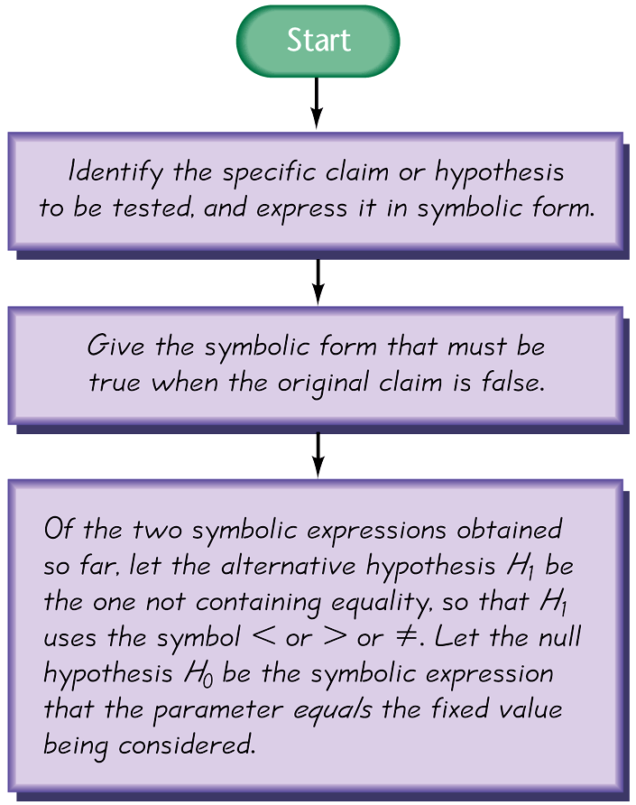
Note about Identifying H₀ and H₁

Slide 14
Example: Identify the Null and Alternative Hypothesis. Refer to Figure 2 and use the given claims to express the corresponding null and alternative hypotheses in symbolic form.
The proportion of drivers who admit to running red lights is greater than 0.5.
b) The mean height of professional basketball players is at most 7 ft.
c) The standard deviation of IQ scores of actors is equal to 15.

Slide 15
Example: Identify the Null and Alternative Hypothesis. Refer to Figure 8-2 and use the given claims to express the corresponding null and alternative hypotheses in symbolic form.
a) The proportion of drivers who admit to running red lights is greater than 0.5. In Step 1 of Figure 8-2, we express the given claim as p > 0.5. In Step 2, we see that if p > 0.5 is false, then p ≤ 0.5 must be true. In Step 3, we see that the expression p > 0.5 does not contain equality, so we let the alternative hypothesis H₁ be p > 0.5, and we let H₀ be p = 0.5.

Slide 16
Example: identify the null and alternative hypothesis. Refer to figure 8-2 and use the given claims to express the corresponding null and alternative hypotheses in symbolic form.
b) The mean height of professional basketball players is at most 7 ft. In Step 1 of Figure 8-2, we express “a mean of at most 7 ft” in symbols as μ ≤ 7. In Step 2, we see that if μ ≤ 7 is false, then µ > 7 must be true. In Step 3, we see that the expression µ > 7 does not contain equality, so we let the alternative hypothesis H₁ be µ > 0.5, and we let H₀ be µ = 7.

Slide 17
Example: Identify the Null and Alternative Hypothesis. Refer to Figure 8-2 and use the given claims to express the corresponding null and alternative hypotheses in symbolic form.
c) The standard deviation of IQ scores of actors is equal to 15. In Step 1 of Figure 8-2, we express the given claim as σ = 15. In Step 2, we see that if σ = 15 is false, then σ ≠ 15 must be true. In Step 3, we let the alternative hypothesis H₁ be σ ≠ 15, and we let H₀ be σ = 15.

Slide 18
Test Statistic
The function of sample observation which is used to verify the null hypothesis is known as test statistic.
The test statistic is a value used in making a decision about the null hypothesis, and is found by converting the sample statistic to a score with the assumption that the null hypothesis is true.

Slide 19
Test Statistic - Formulas
z = p - p

Test statistic for proportions
√
pq
n
x - µ_{x}
z =
Test statistic for mean
σ
n
(n – 1)s²
Test statistic for standard deviation
χ² =
σ ²

Slide 20
Distinctions Between Parameters and Statistics
 | Parameters | Statistics
Source | Population | Sample
Notation | Greek (e.g. μ) | Roman (e.g. x־)
Vary | No | Yes
Calculated | No | Yes

Slide 21
Example: A survey of n = 880 randomly selected adult drivers showed that 56% (or p = 0.56) of those respondents admitted to running red lights. Find the value of the test statistic for the claim that the majority of all adult drivers admit to running red lights. (For this example, assume that the required assumptions are satisfied and focus on finding the indicated test statistic.)

Slide 22
Solution: The preceding example showed that the given claim results in the following null and alternative hypotheses: H₀: p = 0.5 and H₁: p > 0.5. Because we work under the assumption that the null hypothesis is true with p = 0.5, we get the following test statistic:
z = p – p
= 0.56 - 0.5

= 3.56
√
pq
√
(0.5)(0.5)
n
880

Slide 23
Interpretation: We know from previous chapters that a z score of 3.56 is exceptionally large. It appears that in addition to being “more than half,” the sample result of 56% is significantly more than 50%.

Slide 24
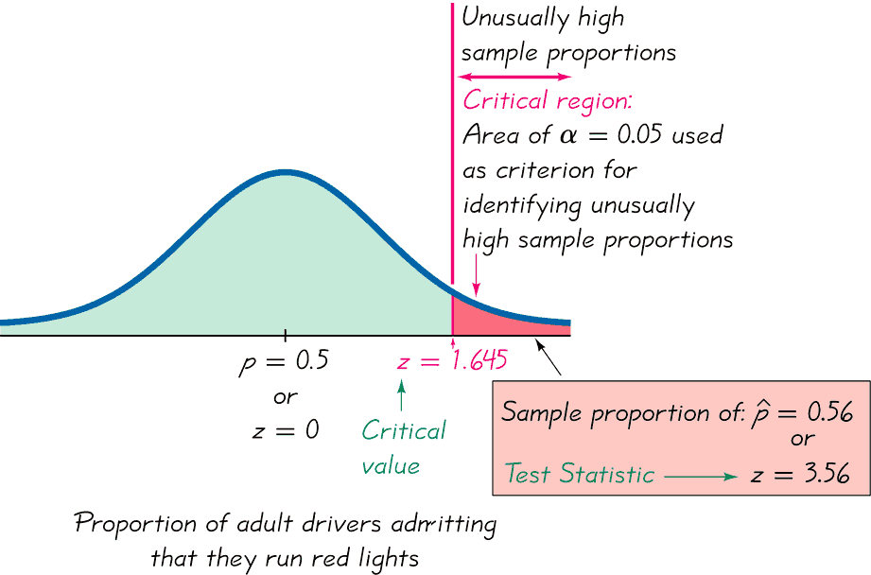
Critical Region, Critical Value, Test Statistic

Slide 25
Critical Region
The critical region (or rejection region) is the set of all values of the test statistic that cause us to reject the null hypothesis. For example, see the red-shaded region in the previous figure.
The area constituted with the values of sample statistic due to which the null hypothesis is rejected even when it is true is called critical region.
It is denoted by C or W

Slide 26
Significance Level
The significance level (denoted by α) is the probability that the test statistic will fall in the critical region when the null hypothesis is actually true. Common choices for α are 0.05, 0.01, and 0.10.

Slide 27
P-Value
The P-value (or p-value or probability value) is the minimum value of α for which the null hypothesis is rejected.
If the p- value is less than or equal to α the null hypothesis is rejected otherwise it is accepted.
The null hypothesis is rejected if the P-value is very small, such as 0.05 or less.

Slide 28
If the p-value is less than the significance level, we reject H₀ and say that the result is statistically significant at the level .
The smaller the p-value, the stronger the evidence we have against the null hypothesis, H₀.
Instead of selecting the critical region in advance, we can report the p-value and consider all the values of that would result in the rejection of the null hypothesis.

Slide 29
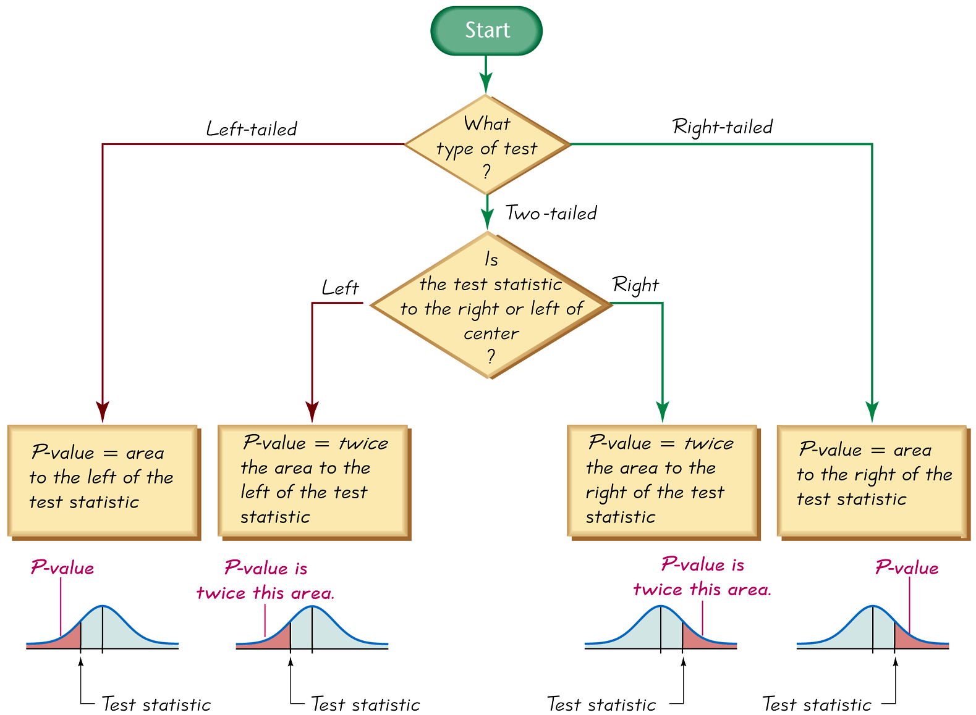
Procedure for Finding P-Values
Figure 8-6

Slide 30
Standard Error
The standard error is an estimate of the standard deviation of a statistic.
The standard error is computed from known sample statistics and it provides an unbiased estimate of the standard deviation of the statistic.
The standard error is important because it is used to compute other measures, like confidence intervals and margin of error.

Slide 31
Standard Error
The table below shows how to compute the standard error for simple random samples, assuming that the population size is much larger than sample size.
Statistics | Standard Error
Sample mean x־ | s/
Sample proportion
Difference between means
Difference between proportions

Slide 32
Type I Error
A Type I error is the mistake of rejecting the null hypothesis when it is true.
The symbol α (alpha) is used to represent the probability of a type I error.
Notes:
Example on page 398 of text

Slide 33
Type II Error
A Type II error is the mistake of failing to reject the null hypothesis when it is false.
The symbol β (beta) is used to represent the probability of a type II error.
Notes:
Page 398 of text

Slide 34
Types of errors
 | Condition
Decision | H₀ true | H₀ false
Accept H₀ | Correct decision | Type II error
Reject H₀ | Type I error | Correct rejection
α ≡ probability of a Type I error
= Pr(rejecting H₀ / H₀ is true )
β ≡ Probability of a Type II error

Slide 35
Controlling Type I and Type II Errors
For any fixed α, an increase in the sample size n will cause a decrease in β
For any fixed sample size n, a decrease in α will cause an increase in β. Conversely, an increase in α will cause a decrease in β.
To decrease both α and β, increase the sample size.
Notes:
page 399 in text

Slide 36
Conclusions in Hypothesis Testing
We always test the null hypothesis. The initial conclusion will always be one of the following:
1. Reject the null hypothesis.
2. Fail to reject the null hypothesis.
Notes:
page 394 of text.

Slide 37
Decision Criterion
Traditional method:
Reject H₀ if the test statistic falls within the critical region.
Fail to reject H₀ if the test statistic does not fall within the critical region.

Slide 38
Decision Criterion - cont
P-value method:
Reject H₀ if the P-value ≤ α (where α is the significance level, such as 0.05).
Fail to reject H₀ if the P-value > α.

Slide 39
Example: Finding P-values. First determine whether the given conditions result in a right-tailed test, a left-tailed test, or a two-tailed test, then find the P-values and state a conclusion about the null hypothesis.
a) A significance level of α = 0.05 is used in testing the claim that p > 0.25, and the sample data result in a test statistic of z = 1.18.
b) A significance level of α = 0.05 is used in testing the claim that p ≠ 0.25, and the sample data result in a test statistic of z = 2.34.

Slide 40
Example: Finding P-values. First determine whether the given conditions result in a right-tailed test, a left-tailed test, or a two-tailed test, then find the P-values and state a conclusion about the null hypothesis.
a) With a claim of p > 0.25, the test is right-tailed. Because the test is right-tailed, Figure 8-6 shows that the P-value is the area to the right of the test statistic z = 1.18. We refer to Table A-2 and find that the area to the right of z = 1.18 is 0.1190. The P-value of 0.1190 is greater than the significance level α = 0.05, so we fail to reject the null hypothesis. The P-value of 0.1190 is relatively large, indicating that the sample results could easily occur by chance.

Slide 41
Example: Finding P-values. First determine whether the given conditions result in a right-tailed test, a left-tailed test, or a two-tailed test, then find the P-values and state a conclusion about the null hypothesis.
b) With a claim of p ≠ 0.25, the test is two-tailed. Because the test is two-tailed, and because the test statistic of z = 2.34 is to the right of the center, Figure 8-6 shows that the P-value is twice the area to the right of z = 2.34. We refer to Table A-2 and find that the area to the right of z = 2.34 is 0.0096, so P-value = 2 x 0.0096 = 0.0192. The P-value of 0.0192 is less than or equal to the significance level, so we reject the null hypothesis. The small P-value o 0.0192 shows that the sample results are not likely to occur by chance.

Slide 42
Hypothesis test for single Proportion
Assumptions:
The sample method is simple random sampling
Each sample point can result in just two possible outcomes. We call one of these outcomes a success and the other is a failure.
The sample includes at least 10 success and 10 failures. (Some text says that 5 success and 5 failures are enough.)
The conditions np ≥ 5 and nq ≥ 5 are satisfied, so the binomial distribution of sample proportions can be approximated by a normal distribution with µ = np and σ = npq .

Slide 43
H₀ : p=p₀
H₁ : { p>p₀ (upper-tail alternative)
p< p₀ (lower-tail alternative)
p≠ p₀ (two-tailed alternative)}

Slide 44
Large-Samples Concerning p
Null hypothesis:
Test statistic value:

Slide 45
Rejection Region :
z > z_{α} (upper-tail rejection region)
z < z_{α} (lower-tail rejection region)
z >_{α/2}(two-tailed rejection region)

Slide 46
Example: An article distributed by the Associated Press included these results from a nationwide survey: Of 880 randomly selected drivers, 56% admitted that they run red lights. The claim is that the majority of all Americans run red lights. That is, p > 0.5. The sample data are n = 880, and p = 0.56.
∧
np = (880)(0.5) = 440 ≥ 5
nq = (880)(0.5) = 440 ≥ 5

Slide 47
Example: An article distributed by the Associated Press included these results from a nationwide survey: Of 880 randomly selected drivers, 56% admitted that they run red lights. The claim is that the majority of all Americans run red lights. That is, p > 0.5. The sample data are n = 880, and p = 0.56. We will use the P-value Method.
∧
∧
p – p
0.56 – 0.5
z =
=
= 3.56
H₀: p = 0.5
H₁: p > 0.5
α = 0.05
pq
(0.5)(0.5)
n
880
Since the P-value of 0.0001 is less than the significance level of α = 0.05, we reject the null hypothesis.
There is sufficient evidence to support the claim.

Slide 48
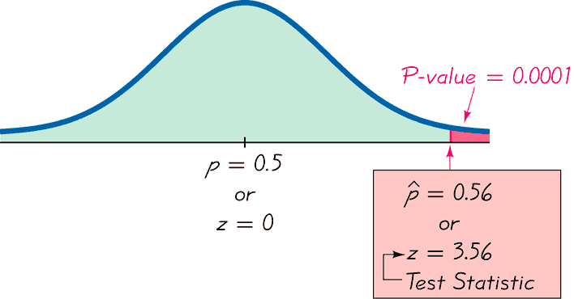
Example: An article distributed by the Associated Press included these results from a nationwide survey: Of 880 randomly selected drivers, 56% admitted that they run red lights. The claim is that the majority of all Americans run red lights. That is, p > 0.5. The sample data are n = 880, and p = 0.56. We will use the P-value Method.
∧
z = 3.56
H₀: p = 0.5
H₁: p > 0.5
α = 0.05

Slide 49
Example: An article distributed by the Associated Press included these results from a nationwide survey: Of 880 randomly selected drivers, 56% admitted that they run red lights. The claim is that the majority of all Americans run red lights. That is, p > 0.5. The sample data are n = 880, and p = 0.56. We will use the Traditional Method.
∧
∧
p – p
0.56 – 0.5
z =
=
= 3.56
H₀: p = 0.5
H₁: p > 0.5
α = 0.05
pq
(0.5)(0.5)
n
880
This is a right-tailed test, so the critical region is an area of 0.05. We find that z = 1.645 is the critical value of the critical region. We reject the null hypothesis.
There is sufficient evidence to support the claim.

